Slide 1
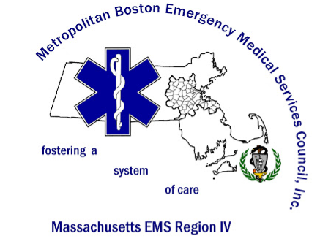
Key to Safety Features in the Electronic Health Record (EHR) – Register the Correct Patient
Public Information Educational Resource Committee

Slide 2
Objectives
Explain the significance of the correct patient data available to ED registration upon arrival of patients to the emergency setting
Define minimum data set for arrival of patients into an HER
Describe the features of an EHR designed for patient safety
Review the risks of inaccurate information

Slide 3
The Joint Commission has made accurate patient identification one of its National Patient Safety Goals since 2003 when the first set of goals went into effect.
The National Quality Forum lists wrong-patient mistakes as serious reportable events and also considers patient identification as a high-priority area for measuring health information technology (IT) safety.
https://www.ecri.org/press/Pages/Patient-Identification-Errors.aspx
Notes:
"E.C.R.I." stands for Emergency Care Research Institute evidenced based research team

Slide 4
Registering the Correct Patient- Fostering a Culture of Safety
Electronic Health Records (EHRs) are defined as:
“a longitudinal electronic record of patient health information generated by one or more encounters in any care delivery setting.”
Included in this information:
patient demographics, progress notes, problems, medications, vital signs, past medical history, immunizations, laboratory data, and radiology reports
EMS ePCRs currently don’t have the ability to communicate with hospital EHRs, the hand-off of patient info between EMS and the Registration staff is imperative.
HIMSS. EHR definition. [Accessed January 31, 2011]. http://www.himss.org/ASP/topics_ehr.asp. [Ref list]
Notes:
Recognizing that registering the wrong John Smith, progress notes, problems, medications, vital signs, past medical history, immunizations, laboratory data, and radiology reports are ALL inaccurate as they are for another patient. Clinicians base decisions and plans for pts around their medical history – having inaccurate information has lead to some preventable medical errors. Taking the time to confirm the correct pt – is the first step to assuring the pt record is correct. Maybe include:
Due to EMS ePCRs inability to communicate with hospital EHRs, the hand-off of pt info between EMS and the Registeration staff is imperative

Slide 5
Barriers to Getting Correct Patient Information Right!
HELP GET IT RIGHT
–
SAVE A LIFE!!
Work with ED Registration!
Collaborate together to define the process to allow safe patient care and the timely - accurate registration of the patient.
Much like an ECG, IV, O2 and ASA are required treatments for an AMI, the correct registration of a patient is required as well.
http://www.nationalacademies.org/hmd/Reports/2006/Hospital-Based-Emergency-Care-At-the-Breaking-Point.aspx
Notes:
IOM …2006 report -
AS an ECG, IV, O2 and ASA are required treatments for an AMI, the correct registration of a pateint is required too.

Slide 6
Key to Safety Features and Delivery of Safe Patient Care Starts at ED Registration/Patient Access
Properly registering the patient relies on:
EMS
the patient
And the patient’s family
to provide accurate information around a few key patient identifiers:
For most EHRs –
Correctly spelled Name
the patient’s DOB and
phone #
This basic information is typically enough to register the correct patient
(some may require additional information for confirmation.)
The aim of this training is focused on the quick arrival process - not full registration,
which should be able to be completed at any time prior to the discharge or admission of a patient.
Notes:
we often need more when trying to confirm an MRN. For example, we will often confirm the address with the patient when we have several matches for the name. As you well know, our EMPI has millions of people in it and search results often return many matches, not just one. EMS often gets frustrated, but I think the point is worth making that registration staff take their task of proper identification seriously and therefore take the extra few seconds to be sure they have the right person before forging ahead.

Slide 7
Standard Process for Data Handoff From EMS to ED Registration
Having this information readily available can speed up patient care and treatment.

Slide 8
Help Get It Right - Save A Life! EMS can help prevent errors!
Lets work to educate EMS providers, patients, ED Registration(Patient Access) and ED nurses and ED providers around the importance of this registration process to establish safe care throughout the ED visit, and potential hospitalization.

Slide 9
Why Is This Important?
The following are several risks that emerge when patient identification and matching fall short.
Patient safety lapses. Proper selection of the medical record at the time of registration is essential for organizations to realize the clinical benefits of their electronic health records
“If the physician does not have all of a patient’s history because we give the patient a new medical record—or worse, we overlay that patient into another patient’s record—there is a deficit of information, which impedes the physician’s ability to make proper decisions.”
These errors have resulted in duplicate therapies, wrong-site or wrong-person surgery, potential allergic reactions, medication dosing errors, and other patient safety issues.”
https://www.hfma.org/PatientID/?trackref=auto
Notes:
Severe life threatening allergic reactions and disabilities have been associated with improper matching of patient medical record creating a new account lacking of historical data.

Slide 10
Why Is This Important?
Decrease Medical errors
Eliminates the clinical decision support and safety checking EHRs afford practitioners
Benefits the collection and storage of historical information

Slide 11
Delays in Care and Clean up…
The process of re-identifying, re-banding, re-labeling all gets in the way of ongoing care, often resulting in blood work being redrawn repeat studies – delaying results and potentially causing harm.
Patient throughput and patient satisfaction suffers.
On the back end, chart correction and HIM clean up as well as redundancy of work on the providers to compensate for demographic errors takes hours of valuable time to correct.
Potential financial losses for EMS and the Health Care System

Slide 12
Direct To Specialty Areas
Point of Entry - direct to specialty areas
Patients that present via EMS to the Emergency room- even following point of entry protocols for “direct to” care - need a STOP for registration and a wristband prior to proceeding.
Cath Lab, CT scan, OR and Labor and Delivery all need the patient to be registered in the EHR prior to procedures- know your hospital system process for the arrival of your POE patients

Slide 13
Emergency Preparedness and Preparing for an Influx of Patients
This work becomes of paramount importance with a Disaster event - and arriving pts quickly in a chaotic environment.
Our goal is to make this normal workflow. So that even in the most chaotic situations the importance of getting the patient registered in the system is seamless for the safe transition in care for the most critical of patients.

Slide 14
THE TAKEAWAY…. Patients ALWAYS Need To Be Registered In The System!
The Electronic Health Record (EHR) system provides:
ED Reg (Patient Access) the ability to verify demographics, add updates for emergency contacts
Place on a wristband and print labels for specimens or clothing
Place/Find patients in the tracking system
Place electronic orders and utilize decision support
Have the benefit of historical data such as allergies (which will provide drug/drug interactions warnings and other medication safety features)
For a patient who is a poor historian and unable to share information: Past Medical/Surgical History, recent hospitalizations and discharge instructions…
Allows the safety feature of bar code scanning of medications and labs
Access to the patients care team and treatment plans
Advance Directives
Notes:
progress notes, problems, medications, vital signs, past medical history, immunizations, laboratory data, and radiology reports” with full reg ,Insurance information .A phone # on arrival is a common requirement for quick reg

Slide 15
Help Get It Right - Save A Life!
Is it time to think about an
Identification Time out??
When we place patient safety as the priority - we get the work done!
Collaborate with the registration staff for the best process at your site for quickly registering patients.

Slide 16
Conclusion - Review
Participants will be able to define minimum data set for arrival of patients into an EHR
Participants will be able to describe the features of an EHR designed for patient safety
Participants will be able to explain the significance of the correct patient data available on arrival of patients to the emergency setting
Participants will be able to list the risks of inaccurate information

Slide 17
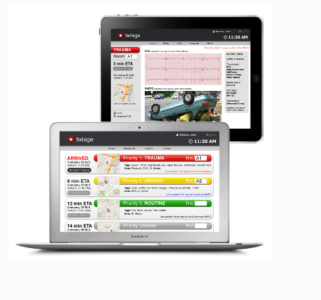
Innovative New options and Future Technology… Correct Patient Information – Help Get It Right - Save a Life !
Kiosks
Patient facing
http://www.track-ems.com/
twiagemed.com/
Notes:
Also Biometrics

